Slide 1
Bail Reform in New York
John F. Pfaff
Friday, February 18, 2022

Slide 2
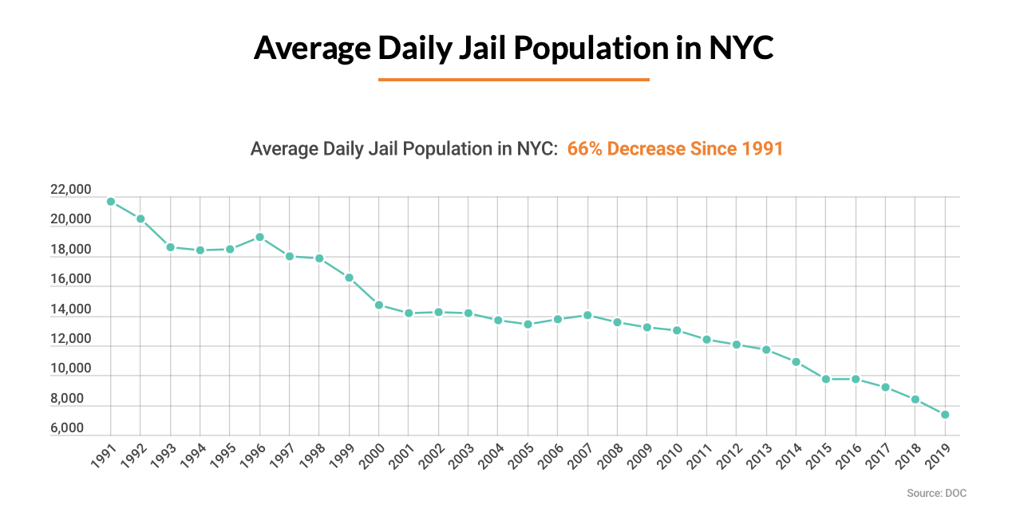
The Long-Run Decline in NYC Jail Populations
Notes:
This is important context for the impact of bail reform in 2020. NYC jail populations (which are mostly people awaiting trial) had been steadily declining since the early 1990s (and, not shown here, the number of NYC residents in state prisons—which hold those convicted of felony offenses—had been declining fairly steadily since the mid-1990s). And during this time, all types of crimes had declined as well.
That is not to say that the decline in jail populations caused the decline in crime; perhaps crime would have declined faster still had jail and prison pops not fallen as fast (though the empirical evidence on the impact of jails and prisons cautions against making that claim too strongly). But it does make it clear that large jail and prison populations are not necessary for keeping crime rates low and falling.

Slide 3
The Impact of Bail Reform
NYC Jail Population
Bail Reform
Bail Rollback
Notes:
Here, then, is the (possible) impact of bail reform on NYC jail populations. Bail reform went into effect on Jan 1, 2020, and then was partially rolled back starting on July 1, 2020.
Two things to note here:
Jail pops had already been falling in 2018 and 2019, so it is likely they would have kept declining into 2020 absent bail reform (and had 2020 been a more-normal year).
Some of that drop in 2020 is clearly due to Covid policies, not bail reform. Even without bail reform, jail pops would have likely dropped in 2020, due to a combination of social distancing practices, declines in misdemeanor arrests, and slowdowns in the court systems.
In general, tying anything in 2020 to specific policies is going to be challenging, because Covid upended SO many things, all at the same time.

Slide 4
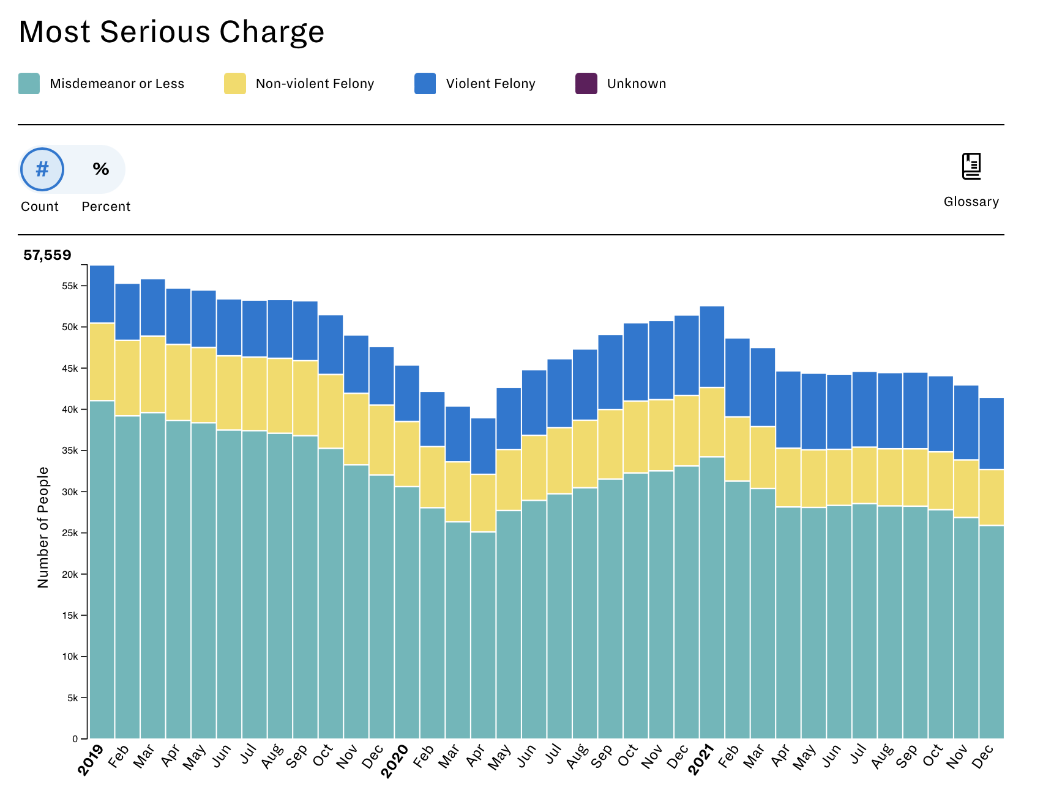
The General Impact of Bail Reform
Bail Reform
Bail Rollback
Notes:
In theory, had 2020 been a “normal” year, bail reform would have led to fewer people locked up in NYC jails (and we do see that), and more people therefore out on pre-trial release. We don’t see the latter effect, however, in no small part because, again: Covid. Everything ground to halt during Covid, so we see the perhaps-otherwise-unexpected result of both jail pops and pre-trial releases falling during the first half of 2020.
It’s true that pre-trial releases rise during the second half (and into 2021)… but that is also a time of rising jail populations as well, which means that some chunk of the rise in pre-trial releases is due to the reawakening of the criminal legal system as a whole as opposed to the specific impacts of bail reform.

Slide 5
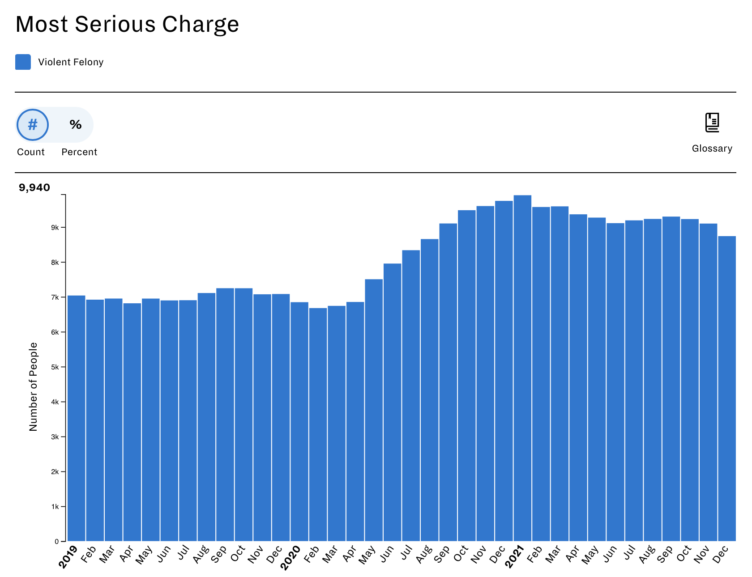
The General Impact of Bail Reform
Bail Reform
Bail Rollback
Notes:
That said, there is one population where we see the expected rise in pre-trial releases after bail reform, and that is those charged with a violent felony. This is not surprising, since this is likely the one category of offense where the criminal legal system tried its hardest to stay functioning during even the early days of the pandemic.
It’s thus worth asking what, exactly, happened with this population.

Slide 6
Rearrests for Violence of Those Charged with Violence
2019
~800 rearrested for violent felonies
~3% of NYPD’s ~27,000 total violent felony arrests
2020
~1,200 rearrested for violent felonies
~5% of NYPD’s ~24,000 total violent felony arrests
~35 additional violent felony arrests per month
~2,000 fewer people in NYC jails per month
Notes:
Here is a rough way to look at the costs and benefits of bail reform, at least when zeroing in on those initially arrested for a violent felony offense (VFO).
Note: “VFO” incorporates a wide range of offenses, from crimes such as murder and armed robbery to lesser assaults and even some burglaries. The list of VFOs is here: https://www.nysenate.gov/legislation/laws/PEN/70.02
In 2019, the year before bail reform, about 800 people who had been charged with a VFO and released pre-trial were subsequently rearrested for another VFO, which are the sort of release outcomes that concern us the most. Those 800 rearrests made up about 3% of the total number of VFO arrests the NYPD made that year.
In 2020, more people were released after being charged with VFOs, as did the total number of those rearrested for a VFO, which rose from 800 to 1,200.
Those 1,200 rearrests were about 5% of the 24,000 VFO arrests the NYPD made in 2020.
To put those in context: in 2020, there were about 35 more VFO arrests per month than in 2019. (And surely not all of those were due to bail reform’s increase in releases, given the uptick in some violent crimes during the pandemic.)
At the same time, there were ~2,000 fewer people in NYC jails each month during 2020.
That is the tradeoff at play here (roughly, given the approximations here)

Slide 7
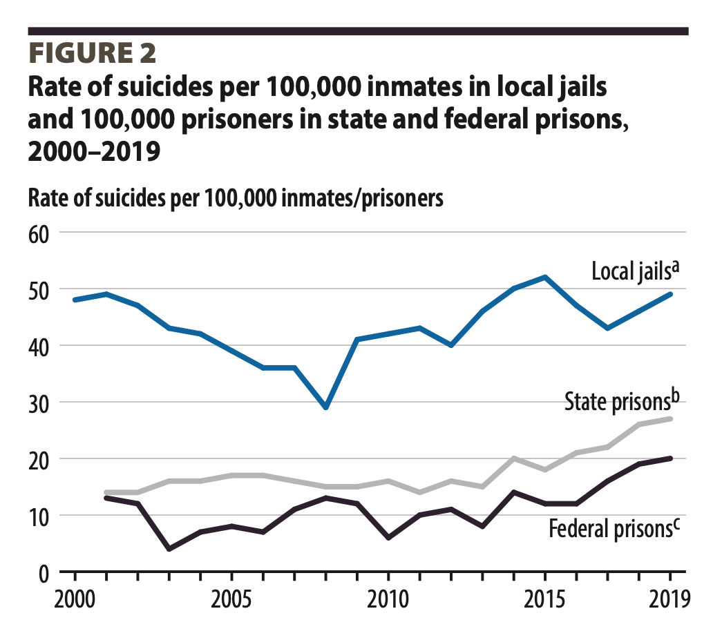
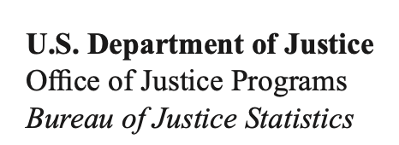
The Costs to Consider
25% increase in long-run employment
60% increase in EITC benefits
15% increase in tax return filings
Notes:
In order to make that tradeoff, we need to be much more honest about the costs of detention. We are quick to point out the costs of letting someone out who then reoffends. But what are the costs of keeping someone in jail?
These are just two (of many) examples:
The suicide rate in jails, at 50 per 100,000, is well above any sort of relevant comparison. The lower red line, at 12 per 100,000, is the suicide rate for Black men (which is relevant given the disproportionate number of Black men held in jails). The slightly higher red line, at 28 per 100,000, is the suicide rate for all men aged 25-44 (which reflects the age of a large bloc of those held in jails). Even if we think that those sent to jail are at greater risk of death by suicide outside of jails than the population as a whole, the high rate in jails—secure facilities where death by suicide should, in theory, be harder—makes it clear that jail are not safe institutions for that population.
The second example, taken from a recent economics paper, shows that being released pre-trial is associated with all sorts of economic benefits, benefits that come from being able to maintain social ties while a case is moving along. The flip side of these results is that when we decide to lock more people up pre-trial, we only further undermine the economic stability of people who already often live precarious lives.

Slide 8
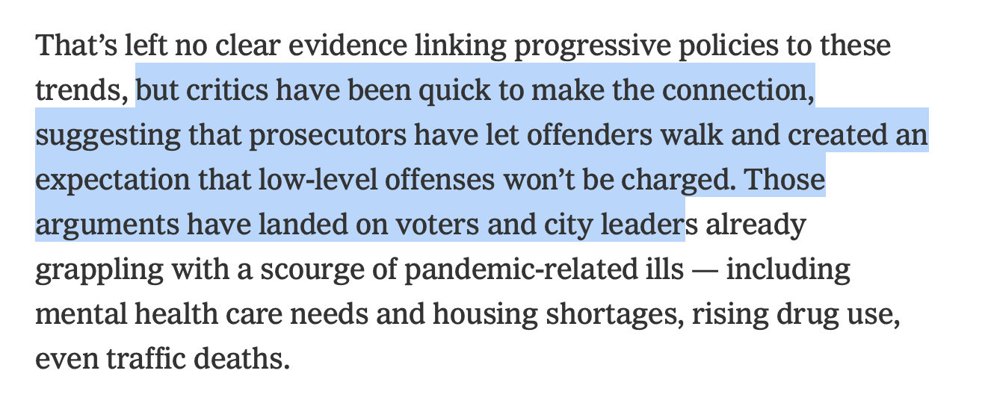
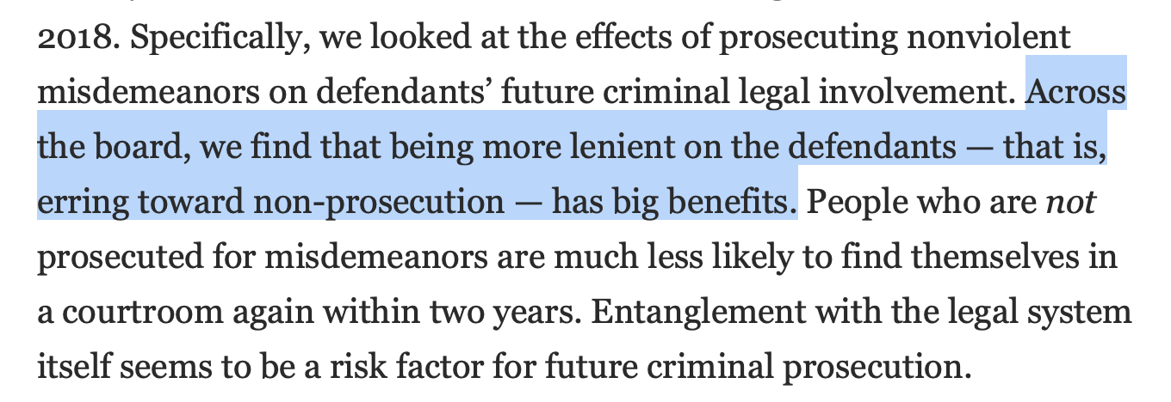
The Data We Ignore
Notes:
Finally, it is important to note that not only do we often fail to talk directly about the real tradeoffs in jail policy, but much of our coverage focuses too much on people’s often-incorrect feelings about that policy.
Take this NY Times article from Feb. 2022. It notes that people feel like progressive DAs are making us less safe by not seeking convictions for low-level offenses. Yet never once does that article discuss what the data says about that, such as a recent academic article using data from Boston which shows that the decision NOT to prosecute misdemeanor cases led to no reduction in public safety, but better life outcomes for those whose charges were dropped.

Slide 9
Sources
Slide 2: https://criminaljustice.cityofnewyork.us/individual_charts/average-daily-jail-population-in-nyc/
Slide 3: https://greaterjusticeny.vera.org
Slides 4 and 5: https://www.nycja.org/pretrial-release-dashboard

Slide 10
Sources
Slide 6:
Reoffense data: https://www.nycja.org/pretrial-release-dashboard
Total VFO arrests:
2019: https://www1.nyc.gov/assets/nypd/downloads/pdf/analysis_and_planning/year-end-2019-enforcement-report.pdf
2020: https://www1.nyc.gov/assets/nypd/downloads/pdf/analysis_and_planning/year-end-2020-enforcement-report-20210721.pdf

Slide 11
Sources
Slide 7:
Jail suicide rates: https://bjs.ojp.gov/sites/g/files/xyckuh236/files/media/document/sljsfp0019st.pdf
Population suicide rates: https://www.nimh.nih.gov/health/statistics/suicide
Dobbie, Goldin, and Yang: https://pubs.aeaweb.org/doi/pdfplus/10.1257/aer.20161503
Slide 8:
NY Times article: https://www.nytimes.com/2022/02/18/us/politics/prosecutors-midterms-crime.html
Agan, Doleac, and Harvey: https://www.nber.org/papers/w28600

